Slide 1
Formal Verification of Programs Equivalence
João Nini
Advisor: Mário Pereira
February 20, 2025

Slide 2
Presentation Structure
Introduction
Background
State of the Art
Preliminary Results
Work Plan

Slide 3
Introduction

Slide 4
Motivation
Annoying bugs in games
Errors in food delivery apps
Therac-25 radiation overdoses
Boeing 737 Max crashes
CrowdStrike outage
Avoidable!
What is the most reliable way?
Deductive verification

Slide 5
Problem Definition
Can we automatically prove that two programs P1 and P2 are correct and equivalent?

Slide 6
Goals and Expected Contributions
Product programs in OCaml
Proof that two programs are equivalent
Facilitate the proof of the hardest through the simplest proof

Slide 7
Background

Slide 8
Hoare Logic

Slide 9
Relational Hoare Logic

Slide 10
OCaml

Slide 11
Why3

Slide 12
GOSPEL

Slide 13
Cameleer

Slide 14
State of the Art

Slide 15
Self-composition

Slide 16
Cross-products

Slide 17
Product Programs

Slide 18
Program Equivalence

Slide 19
Preliminary Results

Slide 20
Simple Equivalence Proof

Slide 21
Equivalence Proof using Product Programs

Slide 22
Work Plan

Slide 23
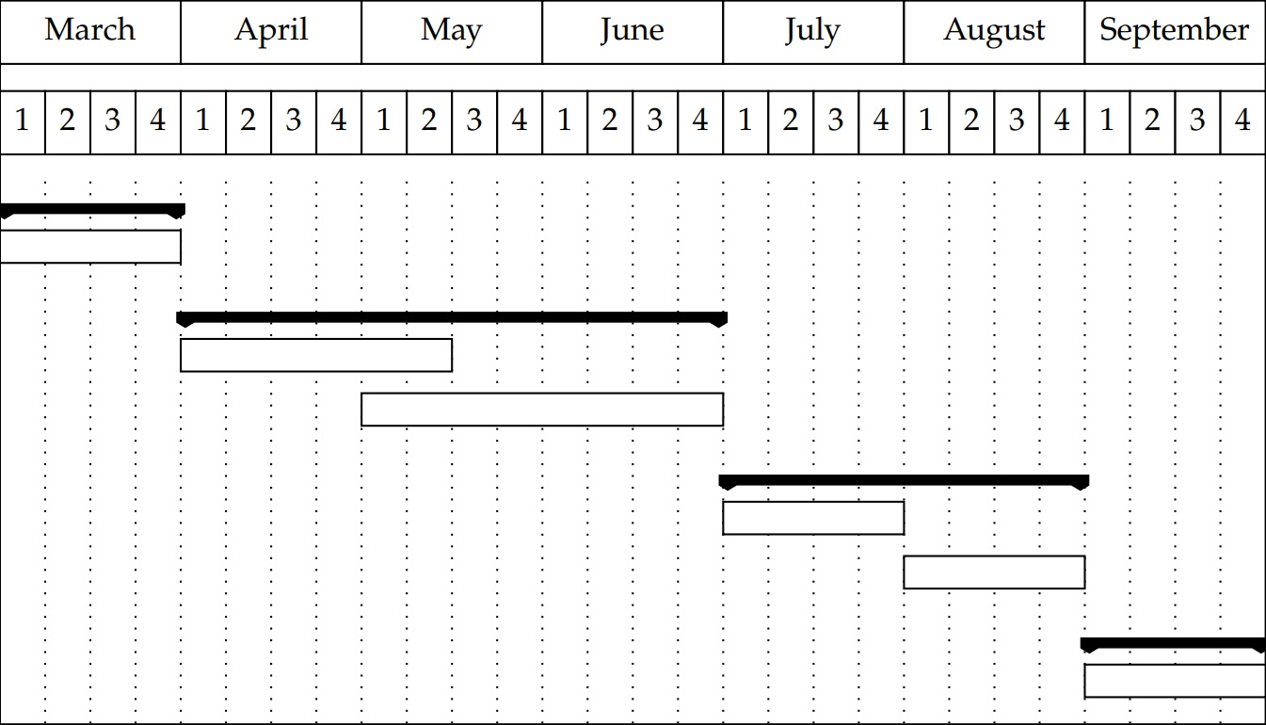
Work Plan
Preliminary
Collection of case studies
First-order product programs
Definition in OCaml
Implementation in Cameleer
Extension to higher-order Definition in OCaml
Implementation in Cameleer
Dissertation
Writing

